Slide 1
HANKOOK Safety Seminar
HANKOOK TIRE
DUBAI OFFICE

Slide 2
CONTENTS
1. Vehicle Accident
2. Function of Tires
3. Survey Result
4. Tire Test
5. Management of Tire

Slide 3
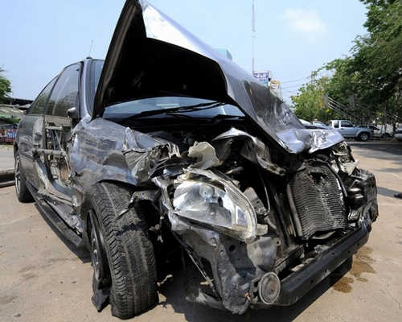
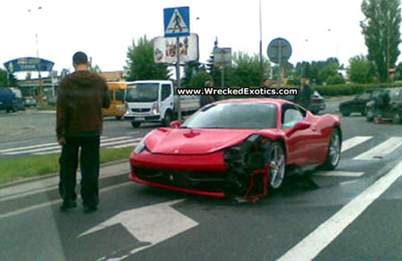
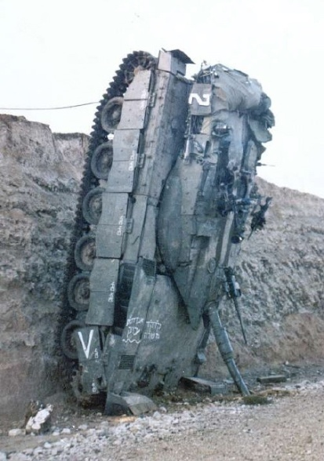
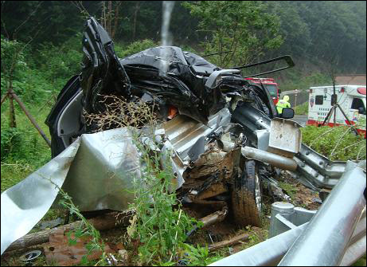
Vehicle Accident
What is the reason of car accidents?
There are a lot of reasons of accidents… . Violence driving, carelessness, sleepiness driving,
over speed, poor management of vehicle and so on.

Slide 4
The Fact
The survey of tire management (in USA)
1. 85% of drivers do not properly check tire inflation pressure.
2. 46% of drivers wrongly believe the correct inflation pressure is printed on the tire sidewall.
3. 26% of drivers wrongly believe the best time to check tires is when they are warm.
4. Only one out of every three drivers know how to tell if tires are bald(worn out).
5. NHTSA estimates that about one in four cars, and one in three light trucks, have at least
one significantly under inflation tire.
The survey of tire management (in Korea)
1. 89% of drivers do not properly check tire inflation pressure.
2. 44% of vehicles have under inflation tires. Espacially, 14% of vehicles have significantly under
inflation tires.
3. Most of drivers check their tires only one or two times per year.

Slide 5
The Fact
Air pressure effect
1. Under normal conditions, air is leaking out 1 psi per month.
It means after 3 month, 10% of air is leaking out, naturally.
2. Every 10% air leaking out, fuel coefficient decreases 1%, mileage of tire decreases 5%, and
the temperature of tires increase 7%.
If you keep good air pressure in your tires,
1. You can decrease driving risks. It is directly connection with you and your family’s life.
2. You can get maximizing fuel economy.
3. You can increase the usage of tires.

Slide 6
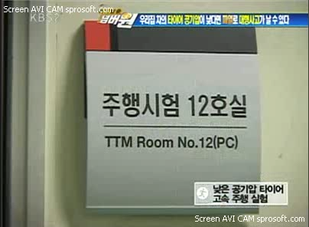
The Test of Tire
Endurance Test of Tires : Air Pressure Test
1. Test for Effect of Tire Pressure.
1. Start : 100km/h
2. Speed Increased : 20km/min
3. Monitored by IR
: Infrared Thermal Camera
4. Result
- After 4 min
: Standing wave
- After 6.5 min
: Run flat
Proper Pressure
30% Under Pressure

Slide 7
Tire Failure statistics (USA)

Slide 8
Truck Fleet Tire Failure Causes (Updated February 2009, Tire Business Magazine)
* Percentages equal approximately 40,000 events
Failure Reason | Percent of Events *
Puncture | 37.3
Impact | 21.6
Run flat | 12.6
Casing separation | 10.7
Tread left less than 2/32 inch | 4.5
Flat due to low air pressure | 3.5
Retread failure | 2.6
Tread separation | 1.8
Brake skid | 1.2
Road hazard | 1.2
Cord showing | 1.1
Cupping | 0.4
Failed valve stem | 0.4
Tread chunking | 0.3
Abuse | 0.2
Repair failure | 0.2
Stolen | 0.2
Tube failure | 0.1
Damaged | 0.0+
72 %

Slide 9
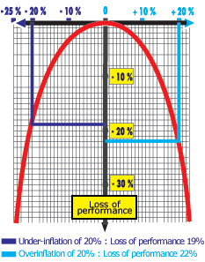
Correlation between Temperature and Pressure

Slide 10
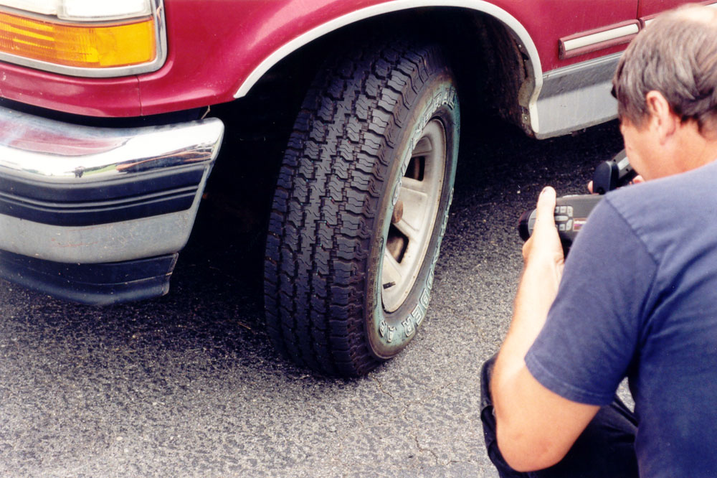
Driving test
After 1 hr Drive

Slide 11
Left Front Control Tire @ 41 psi (100%)
After 1 hr Drive
Photo 10

Slide 12
Left Front Control Tire @ 35 psi
After 1 hr Drive

Slide 13
Left Front Control Tire @ 27 psi
After 1 hr Drive

Slide 14
Left Front Control Tire @ 19 psi
After 1 hr Drive

Slide 15
Left Front Control Tire @ 11 psi
After 1 hr Drive

Slide 16
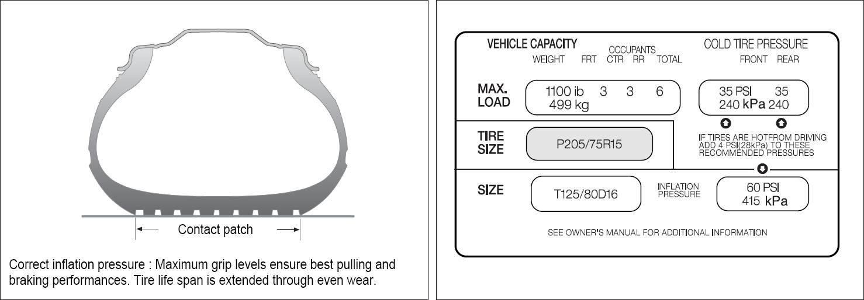
Management of Tire
Tire management
1. Use right size tires for your vehicle.
225 /45ZR17 94 Y K110
Section Width
Pattern Name
Aspect Ratio
Speed Grade
Tire Structure
Load Index
Inch

Slide 17
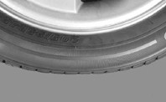
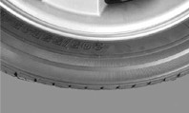
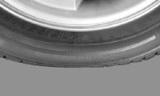
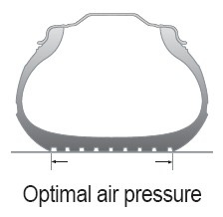
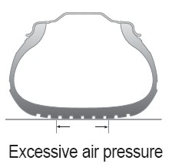
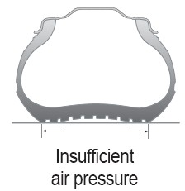
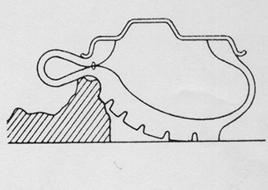
Management of Tire
2. Check air pressure every month – Include spare tire.
Proper Air Pressure
Over Air Pressure
Low Air Pressure
Increase Belt Endurance
Prevent Uneven Wear
Maximum Fuel Coefficient
Maximum Handling Performance
More Susceptible to damage
from external factors
Speed Up Wear, Central Wear
Low Belt Endurance (By Heat)
Low Bead Endurance
Susceptible to Standing Wave
deformation
Speed up Wear, Shoulder Wear
Greater Rolling Resistance
Bad for Sidewall Damage

Slide 18
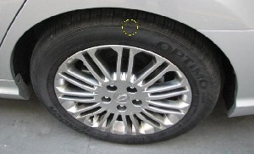
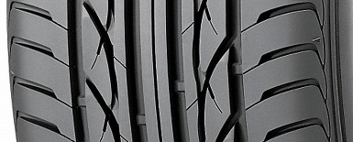
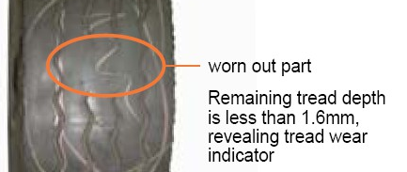
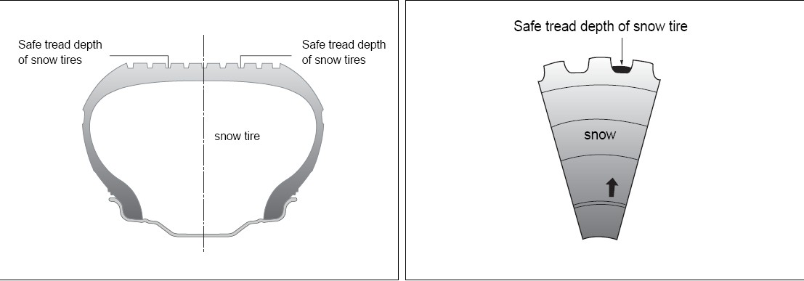
Management of Tire
3. Replacement - Check Tread Wear Indicator
Tread Wear Indicator
Tires have built-in tread wear indicators which mark the minimum allowable tread depth.
The indicators are 4~6 small raised bars which run across the grooves of the tire tread and are 1.6mm in height.
Tires with worn out treads lack the ability to channel water, creating extremely dangerous situation such as slipping.
Platform Mark For Snow Tire
Although the safe tread depth of snow tires is the same as other tires at 1.6mm,
a separate platform marking (↑) shows that when the tread has gone down to that level, the
tire loses its performance as a snow tire and becomes the same as an ordinary tire.

Slide 19
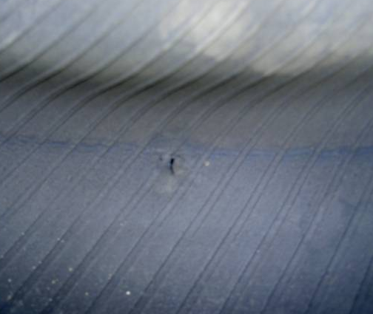
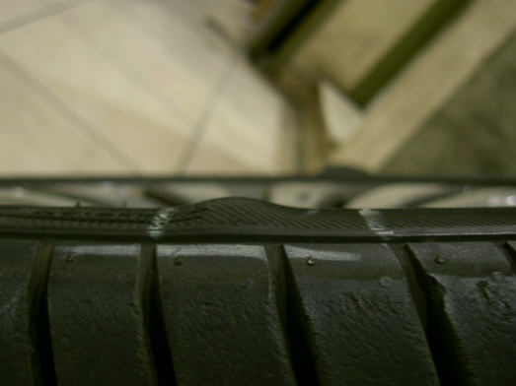
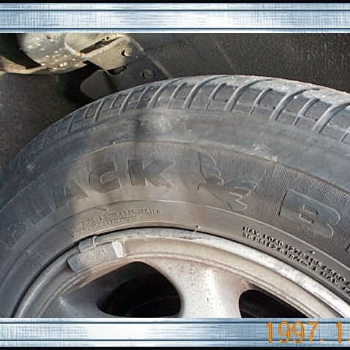
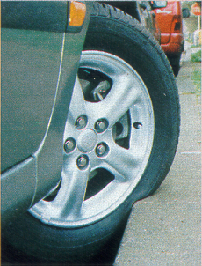
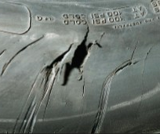
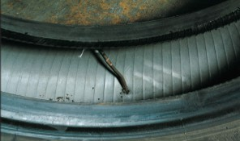
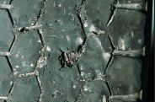

Management of Tire
4. Check external appearance – Damage from External impact
Sidewall Impact
A sever side impact can cause the tire cord to break. This can result in a bulge in the sidewall when inflated.
Check the damage mark in and out side of tires on shoulder and sidewall.
But, sometimes it is very hard to look for the injury portion.

Slide 20
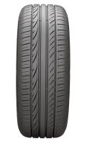
Management of Tire
5. Rotation – Rotate Tires position every 10,000km
Tire Rotation
Even wear on all tires eliminates the need for tire rotation. However, when irregular wear is detected, tires must immediately
be rotated. (Recommend : every 10,000km)
- Benefits of Tire Rotation
1. Prevents irregular wear and extends tire life. 2. Allows easy detection of irregular wear due to vehicle misalignment.
3. Enable easy repair of flat tires
 | Front-Wheel Drive |  | Back-Wheel Drive
Front
Axle
Rear
Axle

Slide 21


